Slide 1
Enterprise AI Design Patterns in .NET 10(LTS) using Foundry
Karthikeyan VK
Microsoft AI MVP

Slide 2
Why AI Design Patterns
AI writes Every code. Why should I care?

Slide 3
Why AI Design Patterns
AI writes Every code. Why should I care?
It works… until it doesn't
Complexity explosion
Hallucinations, false positives
Impossible to prove quality

Slide 4
What are AI Design Patterns ?
AI Design Patterns are reusable approaches for solving common problems when building AI applications and agents.
Use context & data
Know when to call tools
Control hallucinations
Validate & retry output
Handle complex tasks
Judge response quality

Slide 5
Category of AI Design Pattern
Foundation
Intelligence
Reliability

Slide 6
Foundation Design Pattern
Prompts
Context
Instructions
One/Few-shot examples

Slide 7
Intelligence design Pattern
Chaining
Tools
Memory
Reasoning
Orchestration

Slide 8
Reliability
Validation
Retry
Review
Evaluation

Slide 9
DEMO – Basic Chat

Slide 10
Prompt Design & Specificity
Vague prompts produce inconsistent, unpredictable outputs across runs
Generic answers miss actual intent, forcing costly follow-up rounds
No enforced structure or schema means downstream parsing breaks constantly

Slide 11
One/Few-shot Prompting
No reference examples means output varies wildly from what's needed
Higher error rate on edge cases the model hasn't implicitly learned
Teams waste time hand-correcting output instead of steering the model

Slide 12
Prompt Chaining
Mega-prompts degrade quality on multi-step tasks
Errors early in reasoning silently propagate through the response
No way to inspect or reuse intermediate results

Slide 13
Session Context
Every turn feels stateless — the model forgets what the user just said
Users repeat themselves constantly, creating a frustrating experience
Follow-up questions get answered out of context, damaging trust

Slide 14
Persistent Memory
Preferences and history are lost between sessions — every interaction starts from zero
The agent can't personalize responses over time, limiting long-term usefulness
Users must re-explain background repeatedly, increasing friction and cost

Slide 15
Immutable Business Facts
Model can hallucinate or override hard business rules like pricing and policy
Inconsistent answers to the same factual question erode stakeholder trust
No fixed source of truth creates legal and compliance exposure

Slide 16
Validation + Retry
Malformed output flows straight into downstream systems, causing silent failures
No automatic retry — transient errors become hard failures a human must resolve
Bad outputs go undetected until they've already caused damage downstream

Slide 17
Multi-pass Review
First-draft output ships without a quality gate, letting subtle errors reach production
No mechanism to catch reasoning mistakes missed on the first attempt
Quality is capped at whatever a single generation pass can achieve

Slide 18
Self Review
Agent can't catch its own mistakes — errors go straight to the user unchecked
No confidence signal — every answer is treated as equally reliable
Missed chance to auto-correct simple issues before they reach the user

Slide 19
Deep Evaluation

Slide 20
DEMO

Slide 21
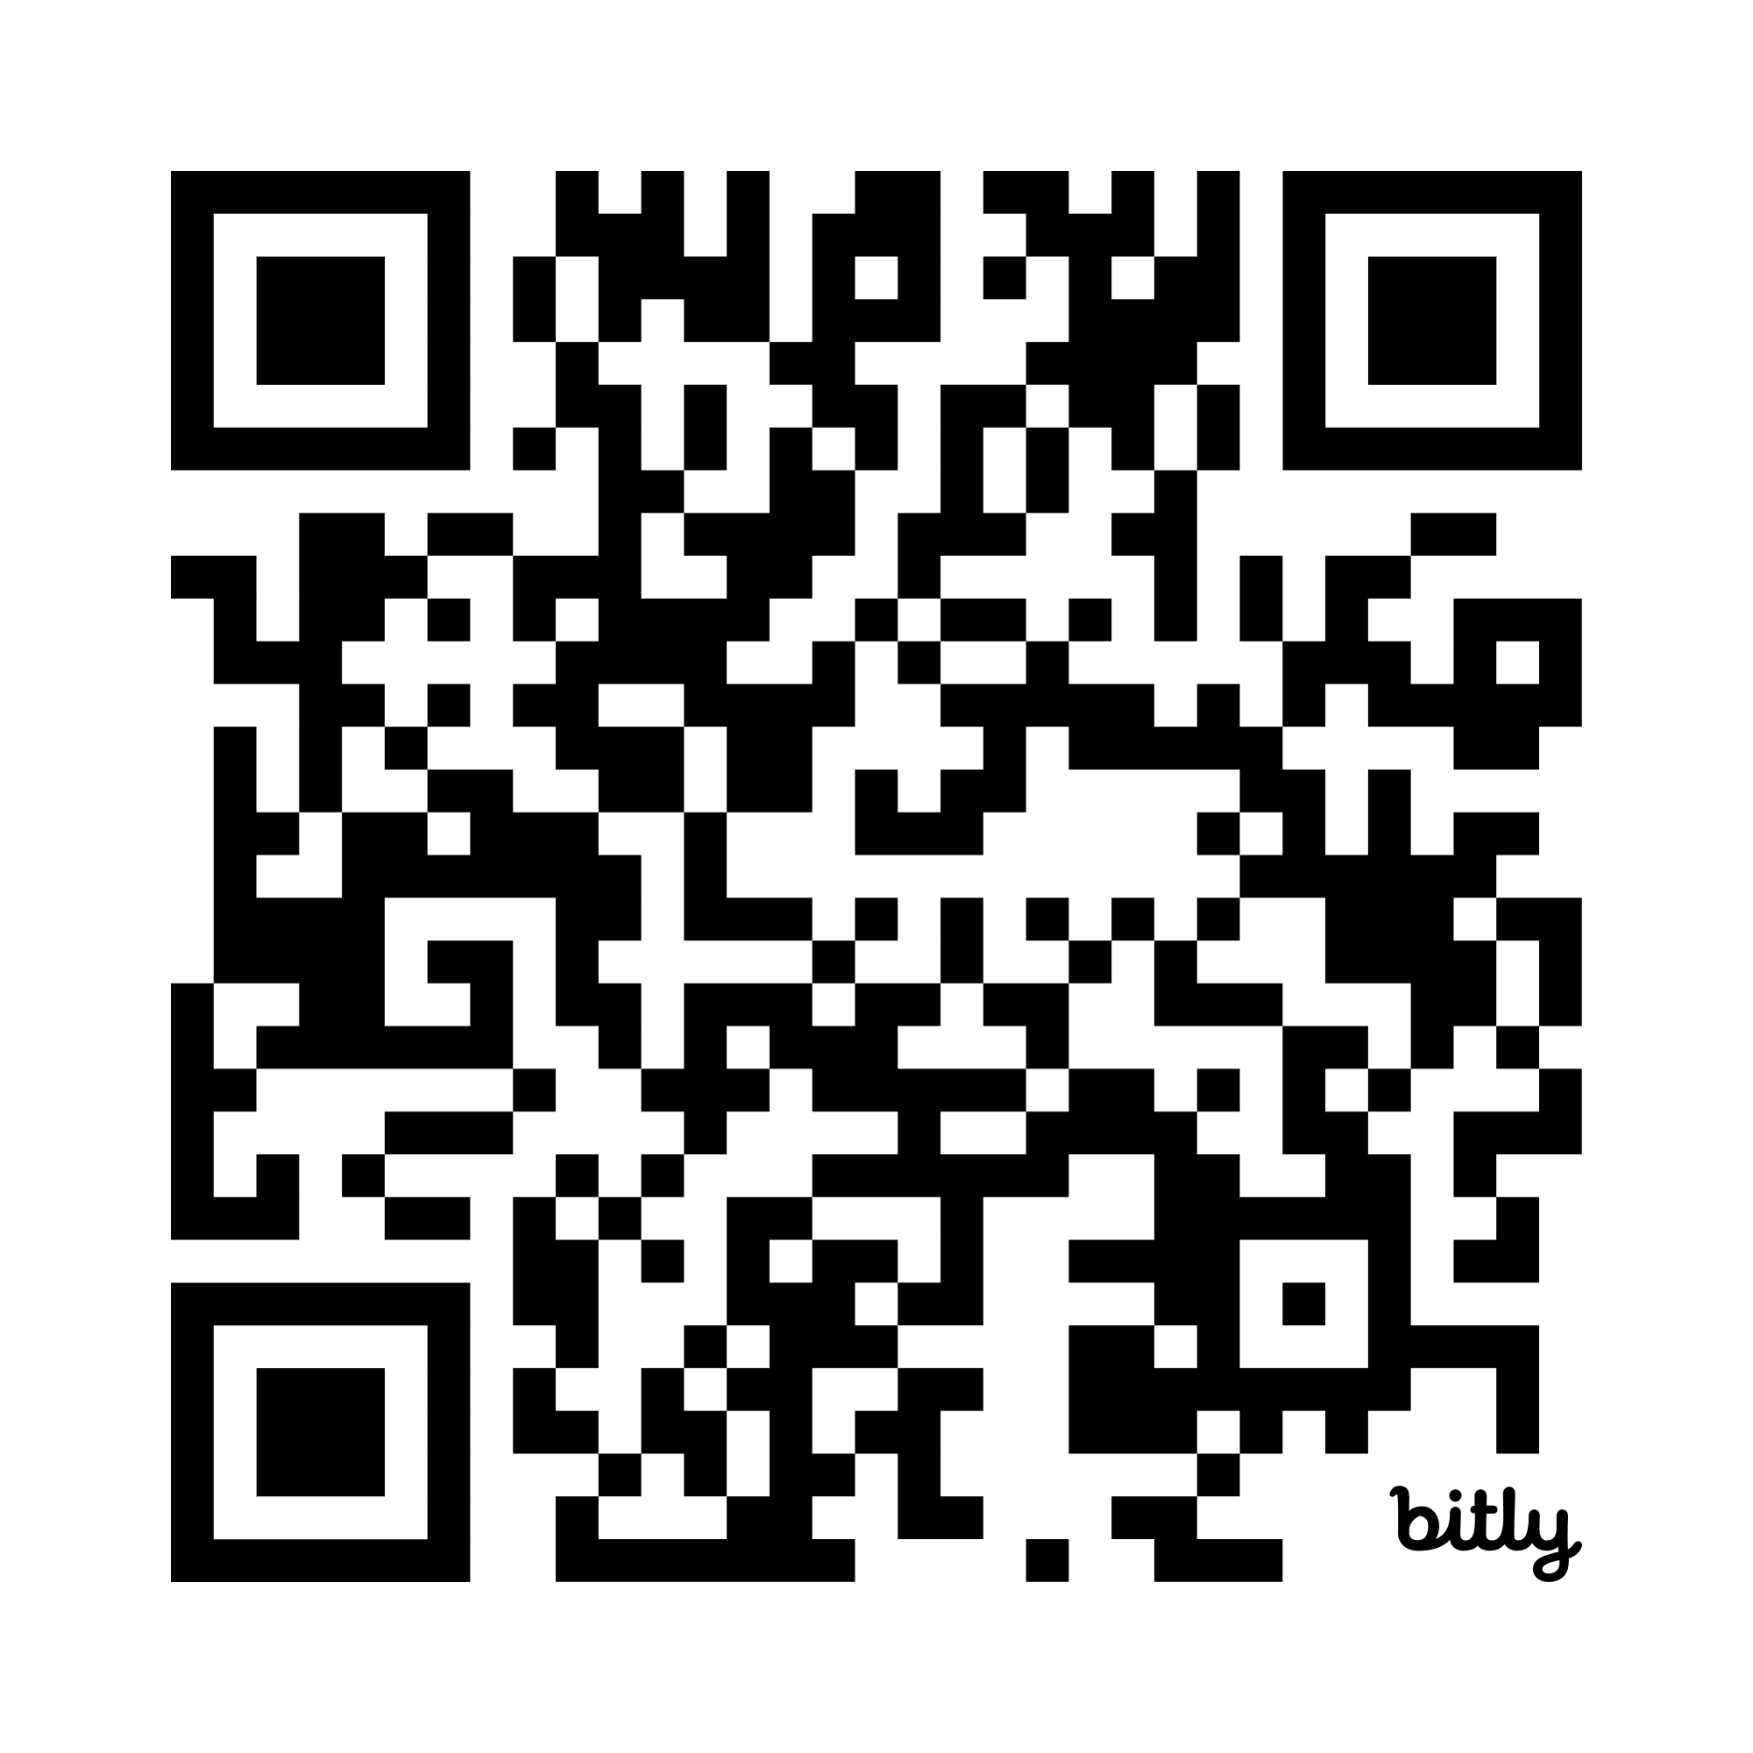
Claude Code - Data Architect Workshop

Slide 22
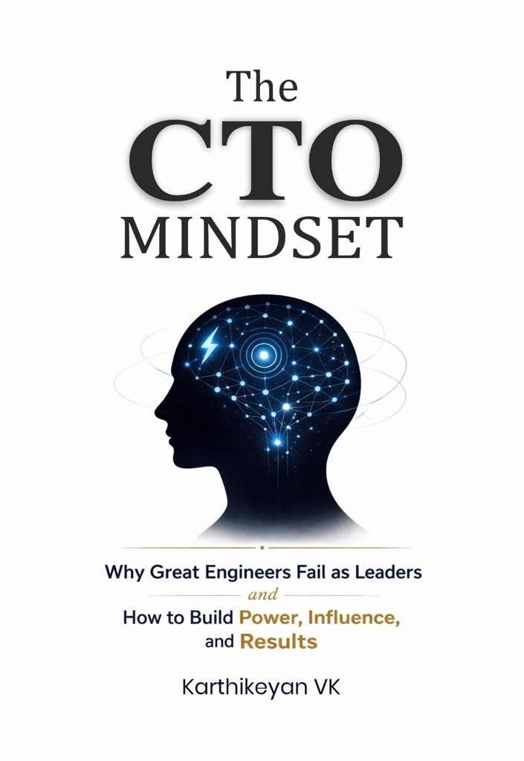

My Books

Slide 23

Connect with me @ LinkedIn

